Slide 1
Web Application Testing DIRECT Asda store
Final Project
Alina Lupu

Slide 2
CONTENT
APP DESCRIPTION
TESTING APPROACH
TOOLS USED
TESTING TYPES
TEST CASE OVERVIEW
BUGS OVERVIEW
TEST CASES RESULTS
CONCLUSIONS
LESSONS LEARNED

Slide 3


APP DESCRIPTION
Direct Asda Store George Clothing
Web application
Online store for groceries, outdoor & garden, clothings and toys
Is the 3rd biggest retailer in UK
International shipping

Slide 4
TESTING APPROACH
Ad-hoc Testing to decide if the web application is worth further testing.
Exploratory Testing for main functionalities like register, search, add to cart, shopping bag, checkout, main tabs.
Document the Exploratory Testing and write down the defects or improvements so they can be replicated.
Focus where bugs were identified, more testing for that area.
Write the Smoke tests and execute them.
Write the Test Report.

Slide 5


TOOLS USED
Mantis Bug Tracker – Bug Reporting
Greenshot– Screenshots Capture
Xmind Tool – Mind Maps
Excel
Word
PowerPoint

Slide 6
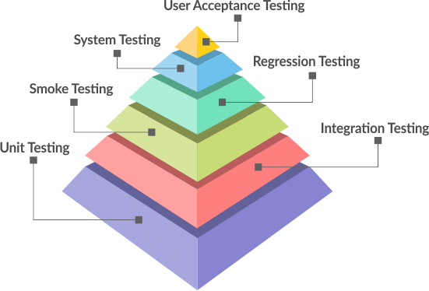
TESTING TYPES
PERFORMED
NOT EXCECUTED
Functional Testing
Non-Functional Testing
ExploratoryTesting
Negative Testing
Positive Testing
Smoke Testing
Compatibility Testing
UI Testing
Usability Testing
Performance Testing
Security Testing

Slide 7
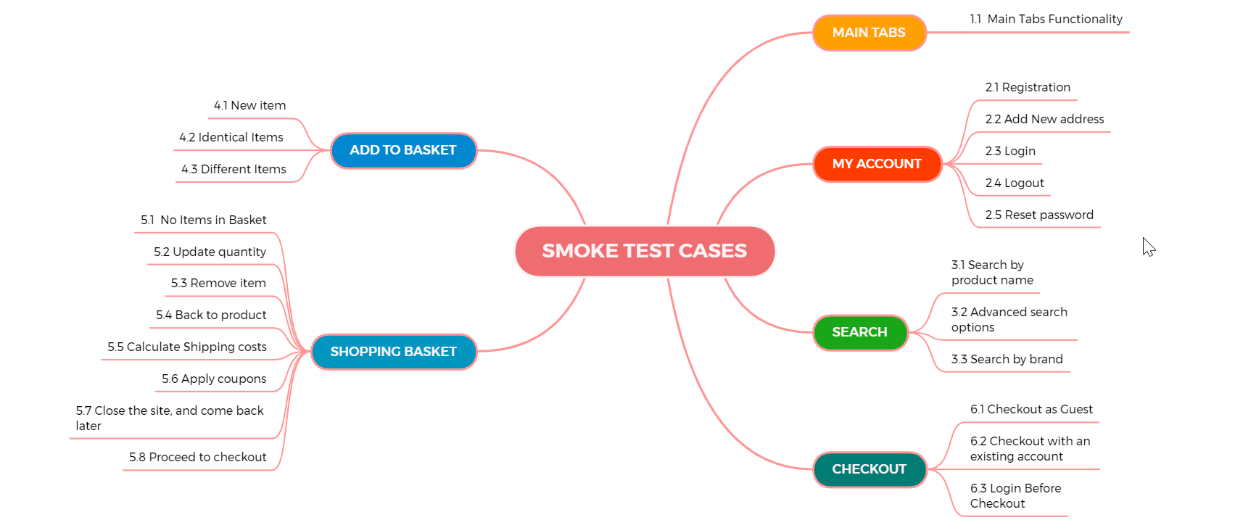
Test case overview Total: 23 Test cases

Slide 8
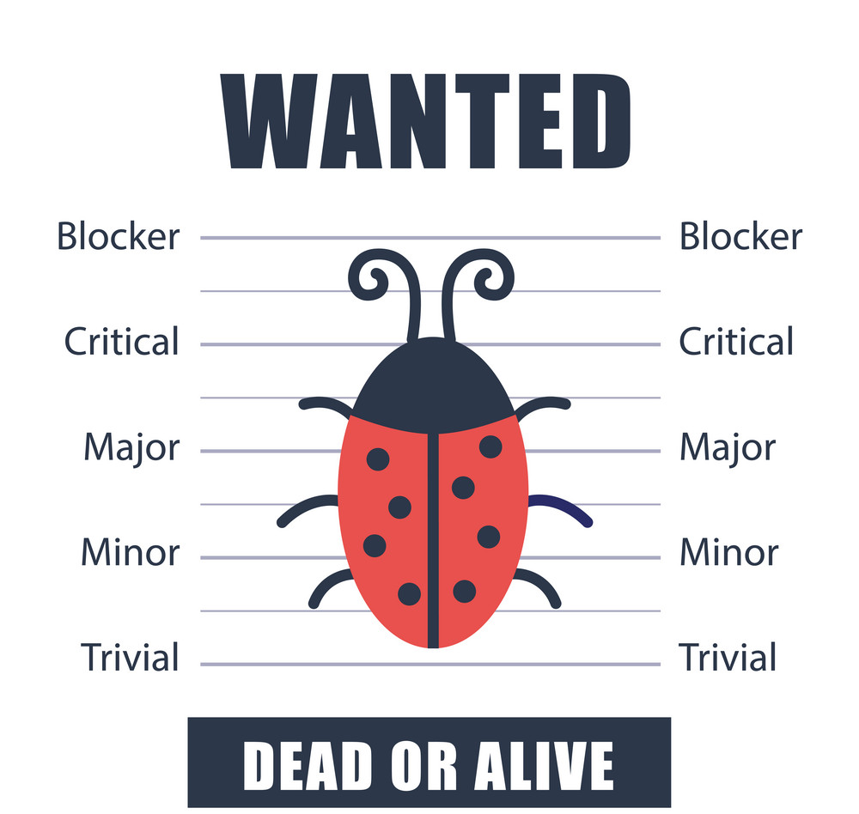
Bugs oversview 15 Bugs 2 improvements

Slide 9
TEST CASES RESULTS
Functionality | Total | Pass | Failed | Blocked | Not Run | Defects
Main Tabs | 1 | 1 | 0 | 0 | 0
My Account | 5 | 4 | 1 | 0 | 0 | Bug ID 0041648
Search | 3 | 2 | 1 | 0 | 0 | Bug ID 0041448
Add to Bag | 3 | 3 | 0 | 0 | 0
Shopping Bag | 8 | 8 | 0 | 0 | 0
Checkout | 3 | 3 | 0 | 0 | 0
Total Results | 23 | 21 | 2 | 0 | 0
Procentage | 100.00% | 91.3% | 8.7% | 0.00% | 0.00%

Slide 10

conclusions
15 Bugs and 2 improvements were identified : 3 major and 12 normal .
23 Test Cases were executed and a number of 21 passed and 2 related to Search and My Account, failed.
During the execution of the exploratory testing and Negative Testing were identified 13 Bugs and 2 Improvements.
Data type used during testing – valid, invalid, blank, volume data.
Compatibility testing was also performed, for different browsers and devices. The bugs reproduce on all browsers.
The web application is already in production, although the application could be improved and the 3 major severity bugs fixed.

Slide 11

Lessons learned
“Software Testing Is About Mind And Eyes”
Software testing is challenging, constant learning, understanding priority.
The most challenging was the lack of documentation.
Find important bugs fast.
Write the test cases steps and the expected result for each.
Exploratory Testing facilitates learning of functionalities.
Executed Exploratory Testing for 6 functionality to find defects.
Reporting bugs.
Web application is already in production.

Slide 12


Thank you !
The END!

